Slide 1
Camp track App Admin User Guide
Prod URL:
https://camp-qr-checkin.web.app/
Test URL:
https://camp-qr-checkin-test.web.app/
Disclaimer: All personal and church names shown in this guide are fictitious and used solely for illustration purposes.

Slide 2
Options available for all user types
The actions in this section are available to both Camp Leader and Admin users.
They are also included in the Camp Leader manual.
For admin-only actions, skip ahead to page 18.

Slide 3
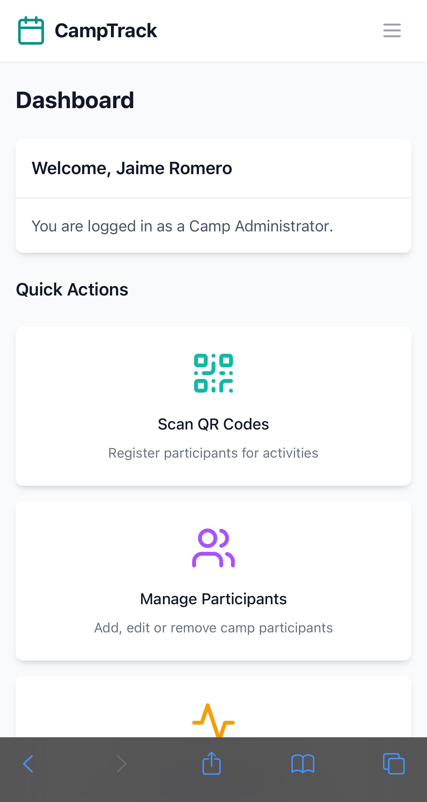
Dashboard and App icon
First, we recommend adding the app to your home screen for quick access. Tap the page options menu to begin.

Slide 4
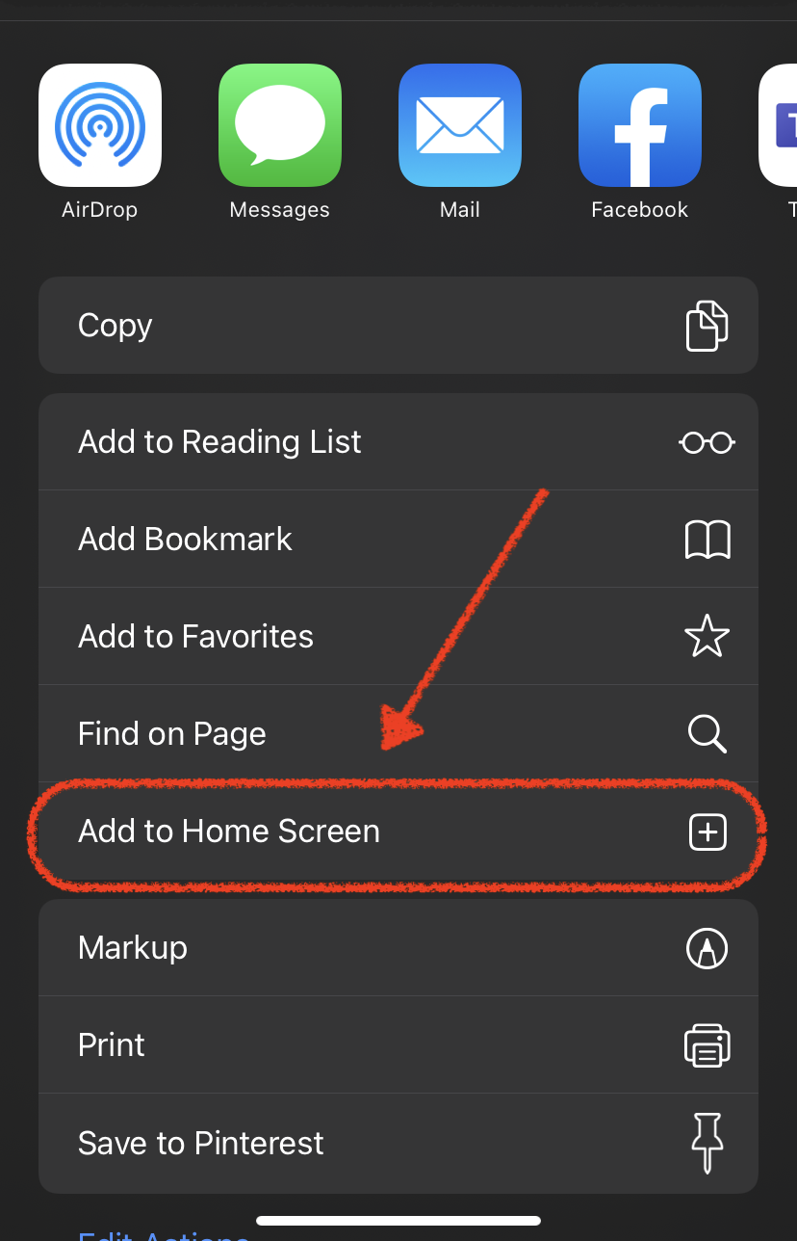
Dashboard and App icon
Then simply select “Add to Home Screen.” This step should look similar on both iPhone and Android.
If prompted, enter a simple name for your icon (e.g., “CampTrack”).

Slide 5
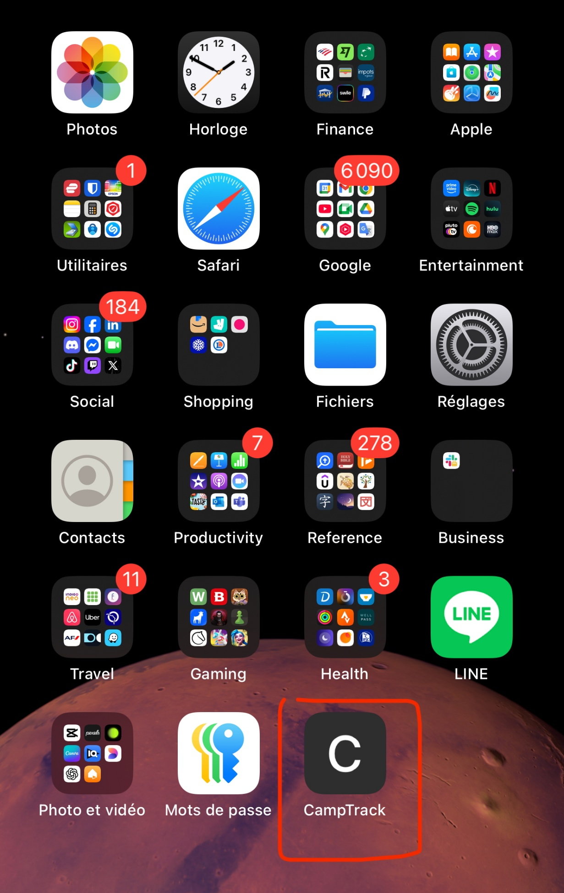
Dashboard and App icon
You should now see the web app icon on your Home Screen, making it easy to access anytime.

Slide 6
Scanning a QR code
To scan a participant’s QR code, tap the Scan quick action from the dashboard or open it from the app menu.

Slide 7
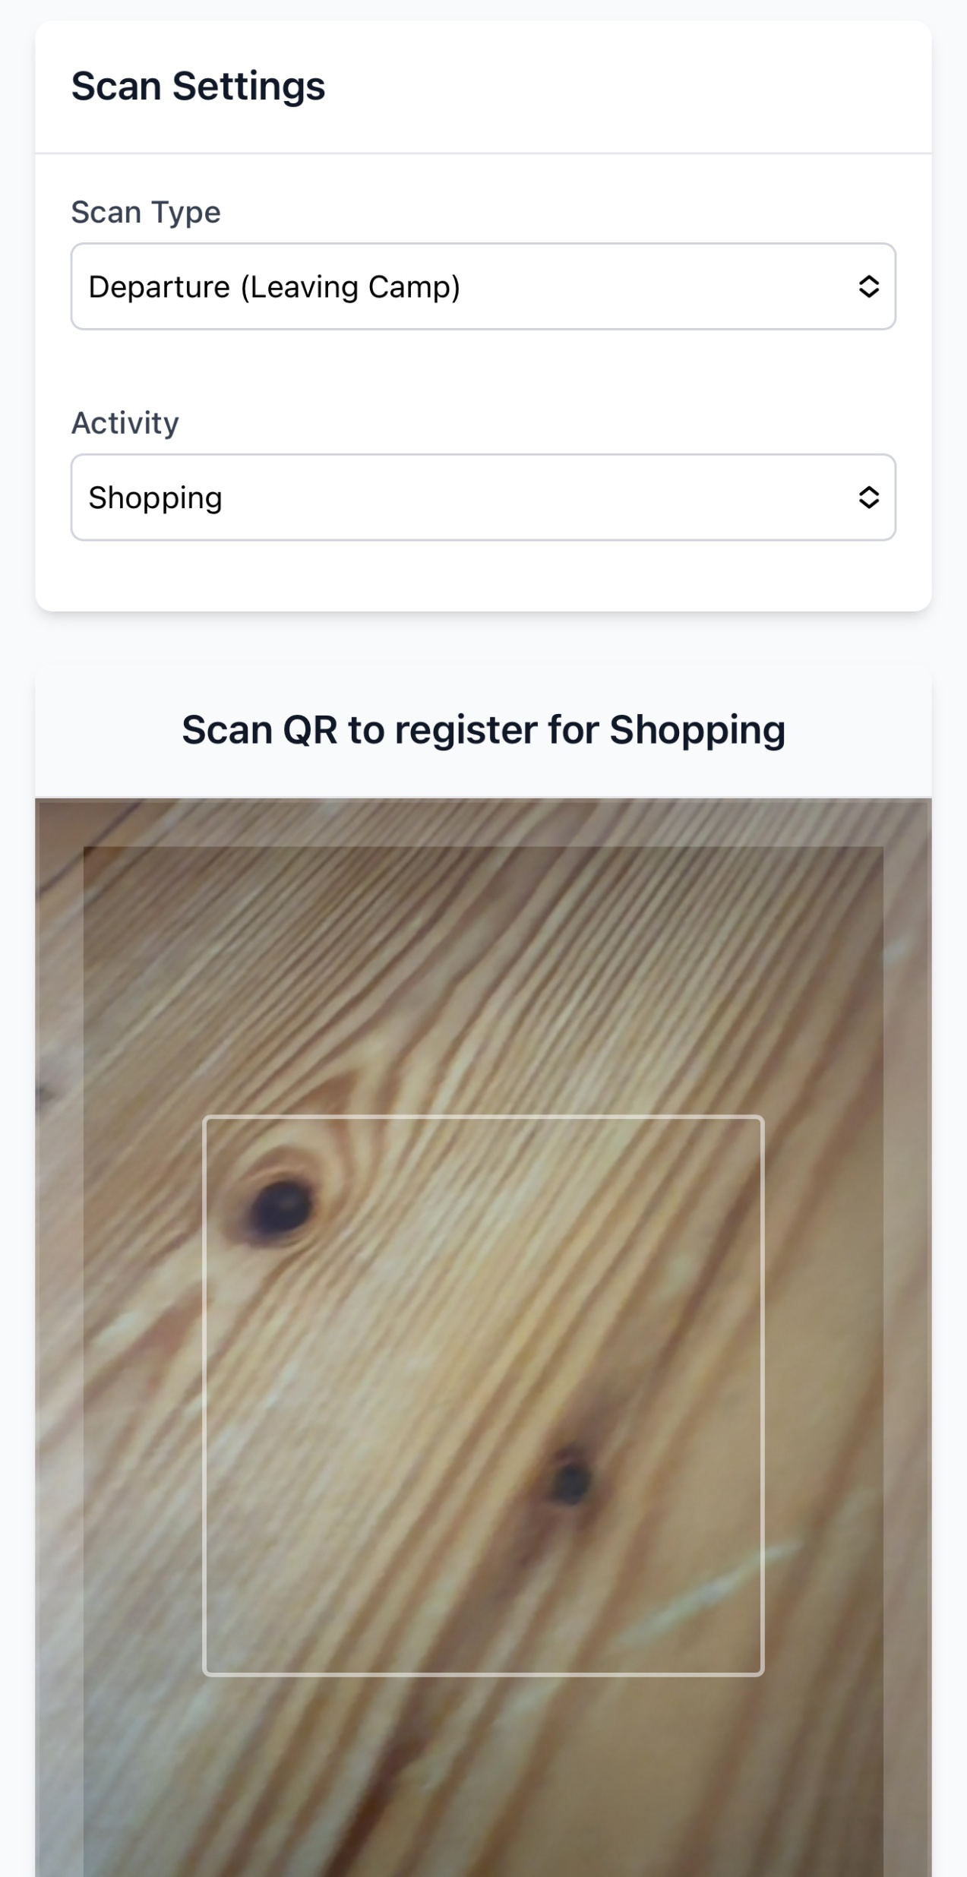
Scanning a QR code
On the Scanner page, select the scan type (departure or return).
If scanning a departure, choose the activity the participant is leaving for.

Slide 8
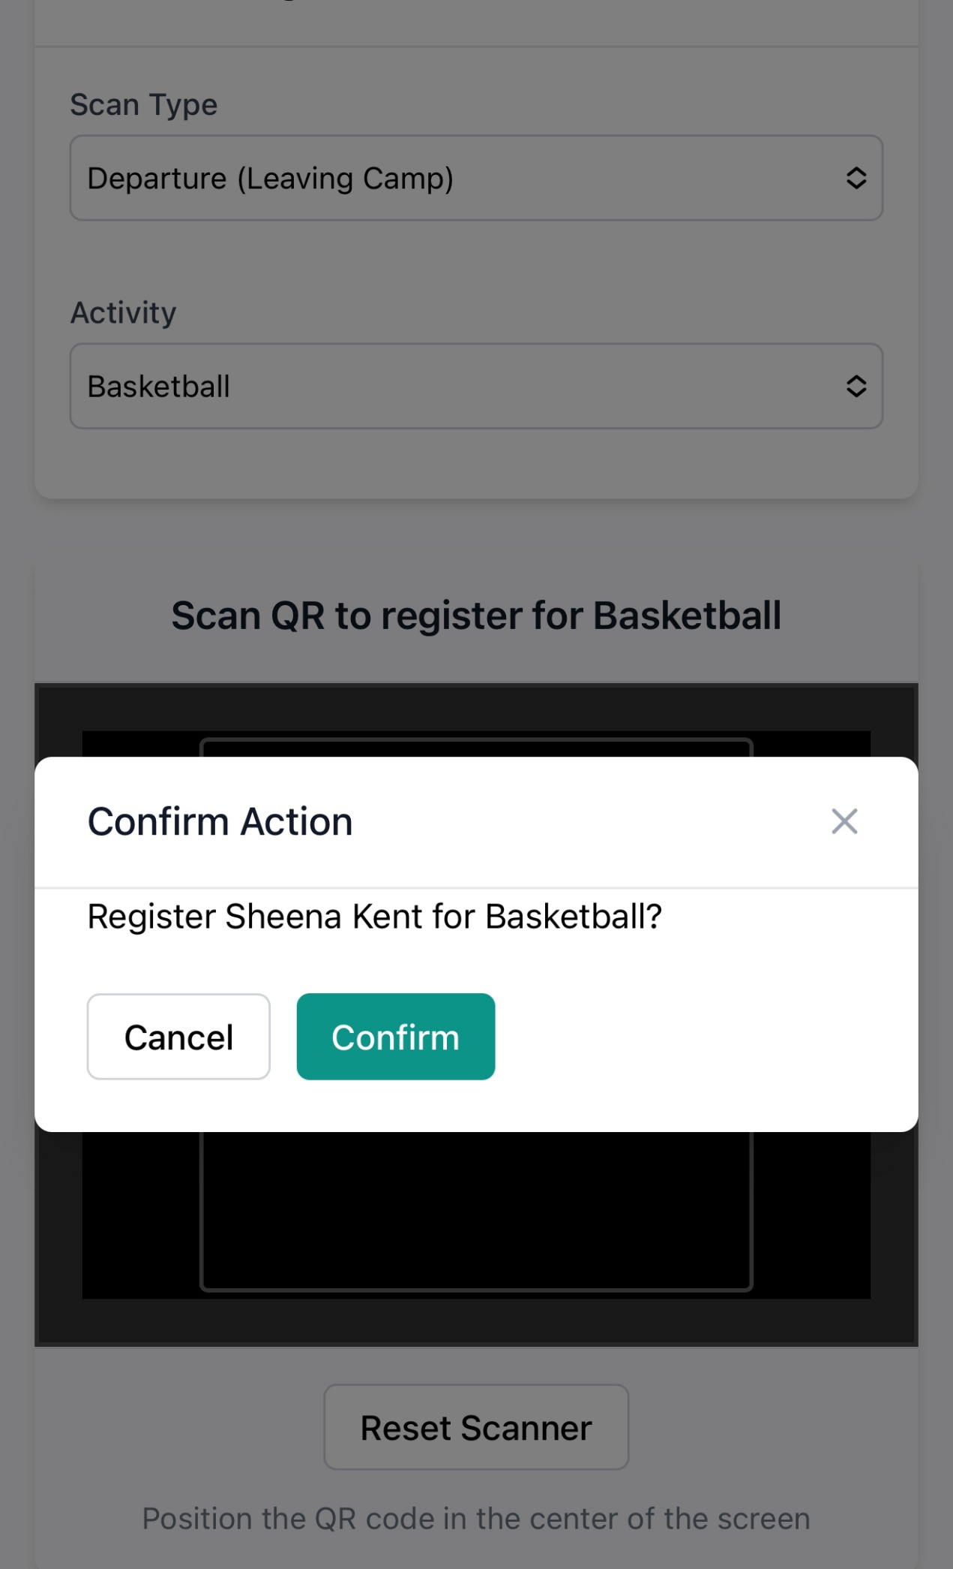
Scanning a QR code
You’ll need to confirm that everything looks correct to complete the scan.
Also, note the Reset Scanner button, which you can use if scanning doesn’t work.

Slide 9
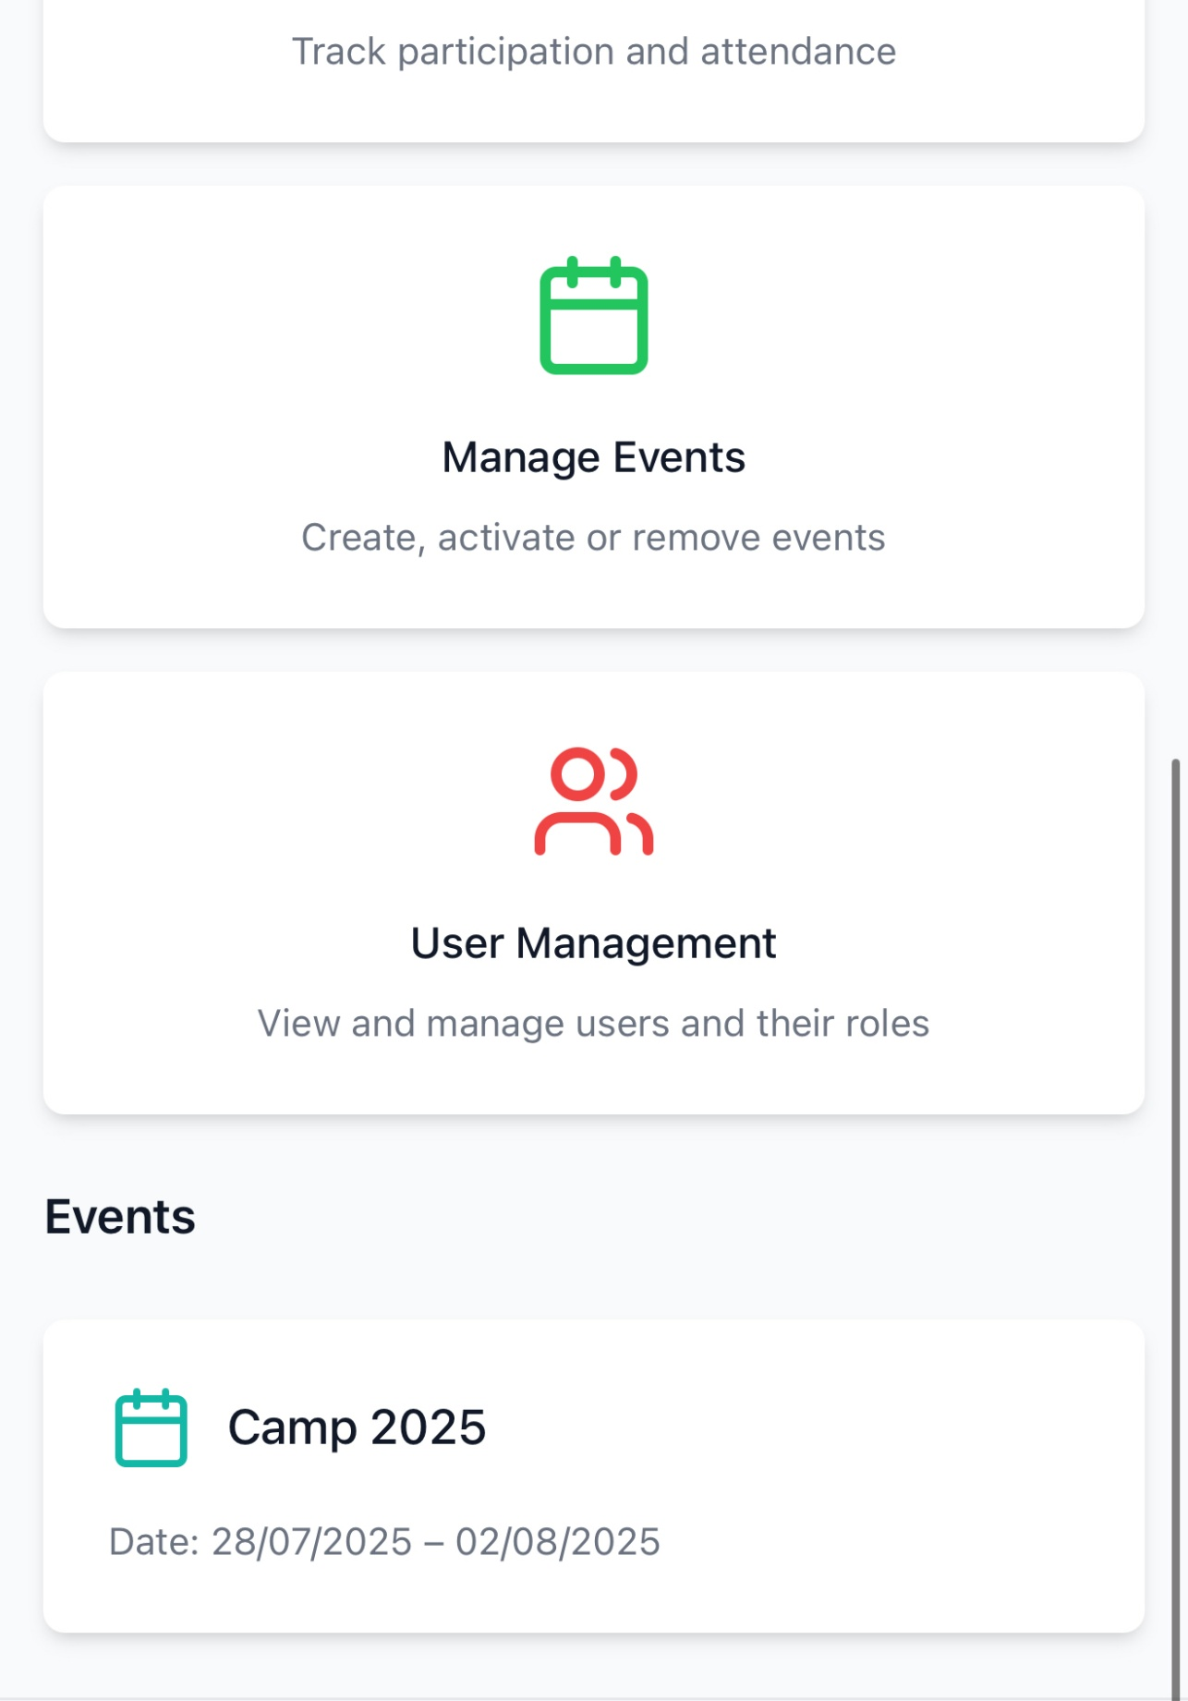
Participant location
From the Dashboard, you can access the Event Detail page to view participant locations and scan history.

Slide 10
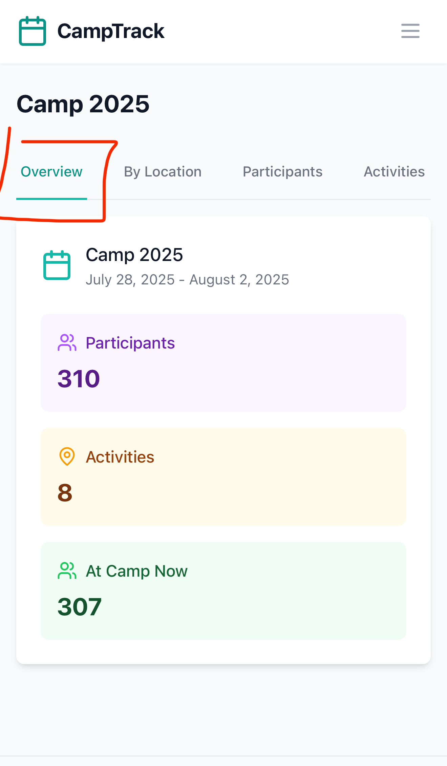
Participant location
In the Overview tab, you can see the total number of participants, the number of activities, and how many are currently At Camp.

Slide 11
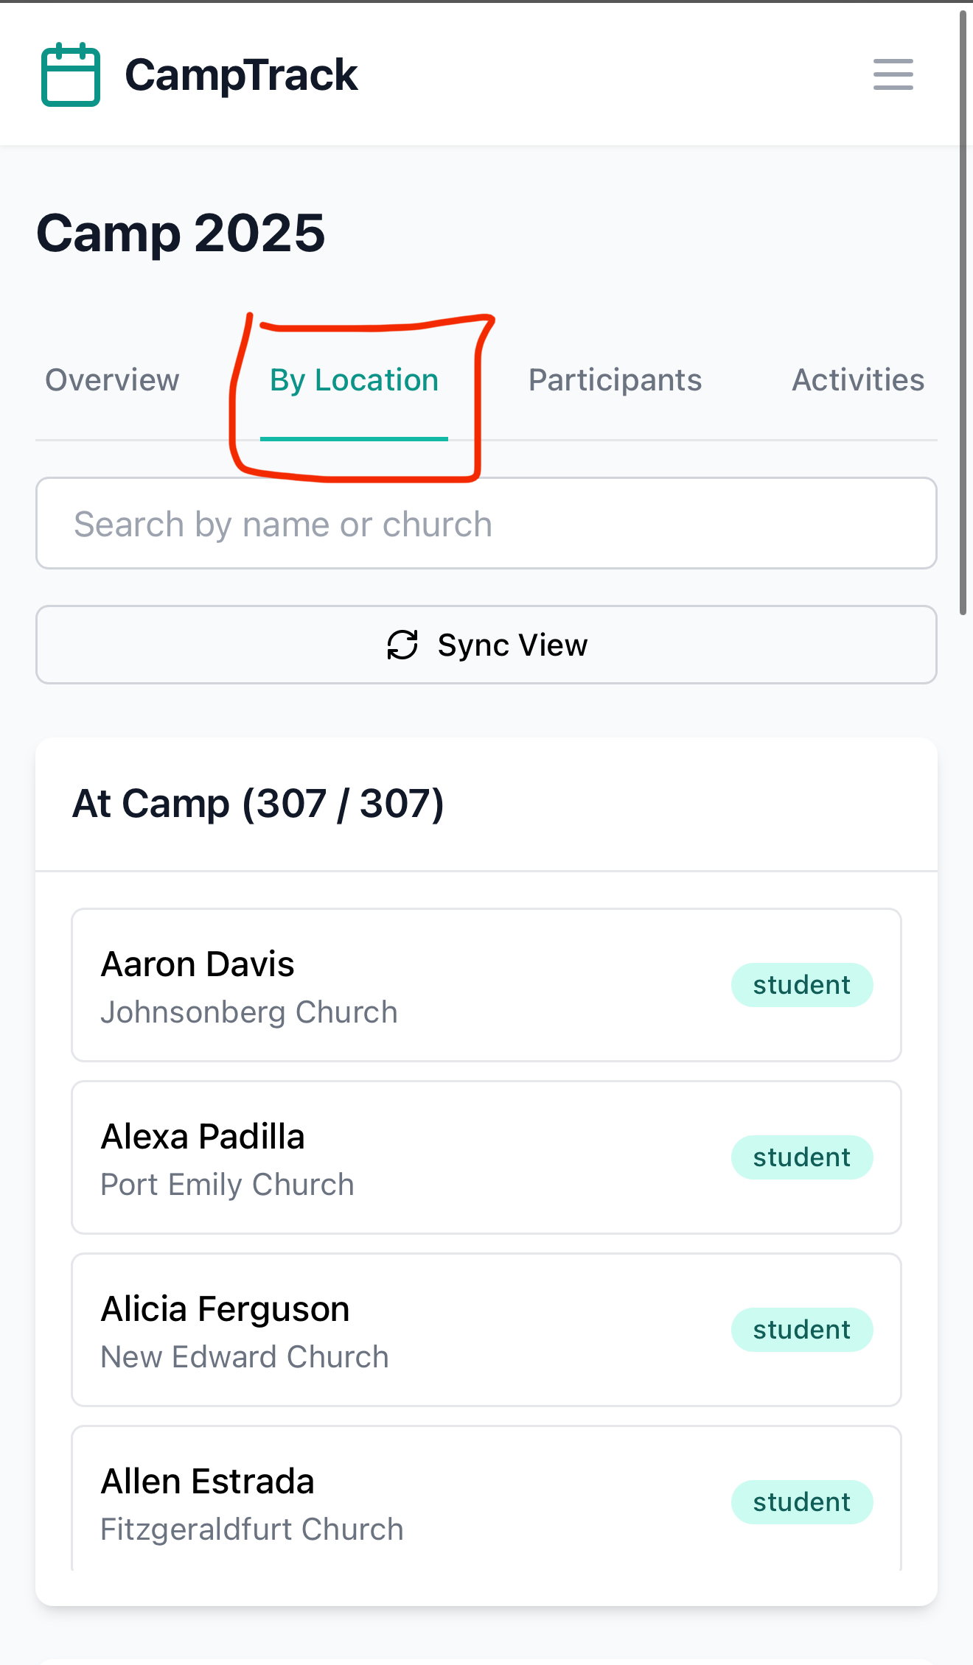
Participant location
In the By Location tab, you can see participants grouped by location.
You can also use the search bar to filter by participant name or church.

Slide 12
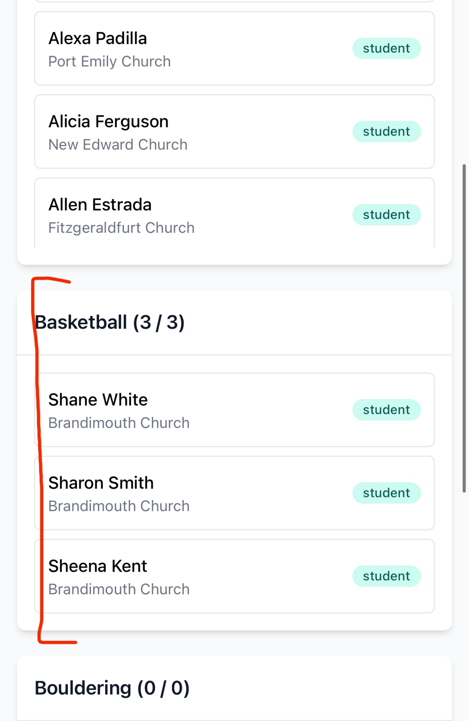
Participant location
As you scroll down, you’ll see participants currently in each scanned location.

Slide 13
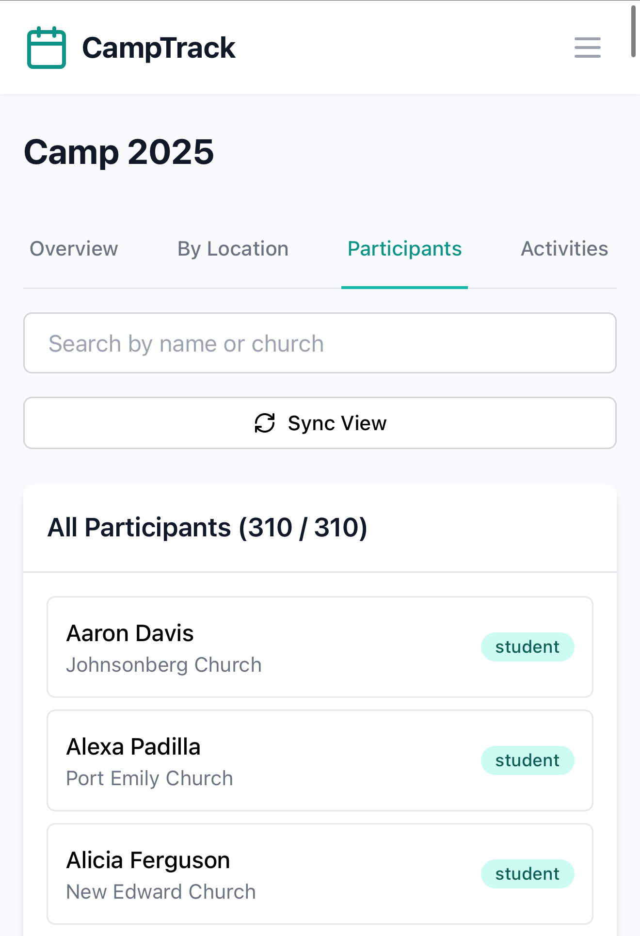
Participant location
In the Participants tab, you’ll find the full list of participants enrolled in the camp.

Slide 14
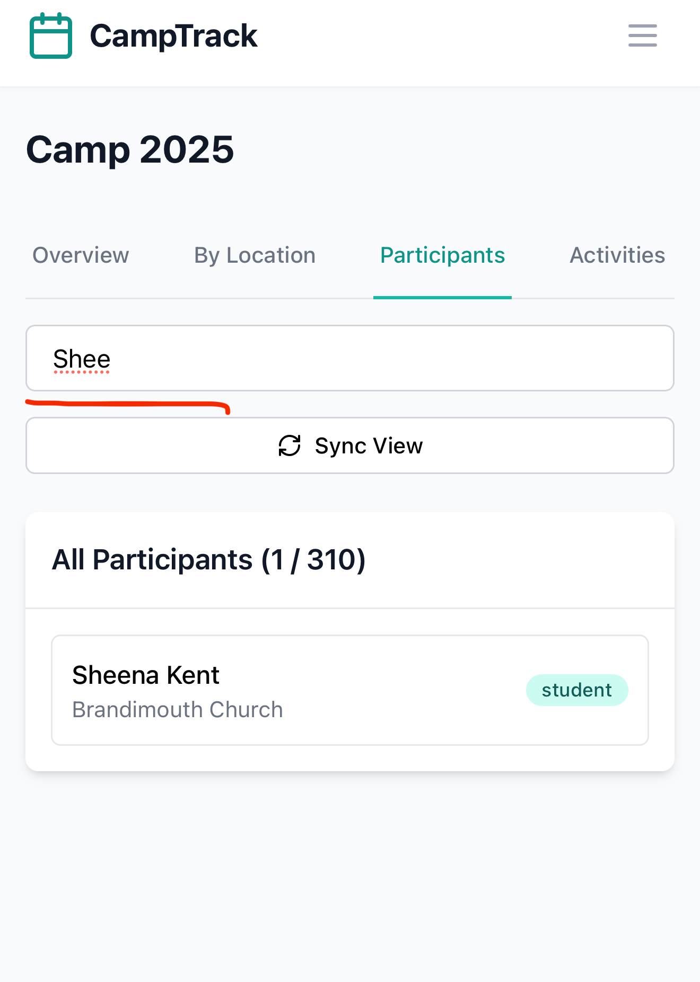
Participant location
In this view, you can also use the search bar to filter results.
Tap any student to view their scan history.

Slide 15
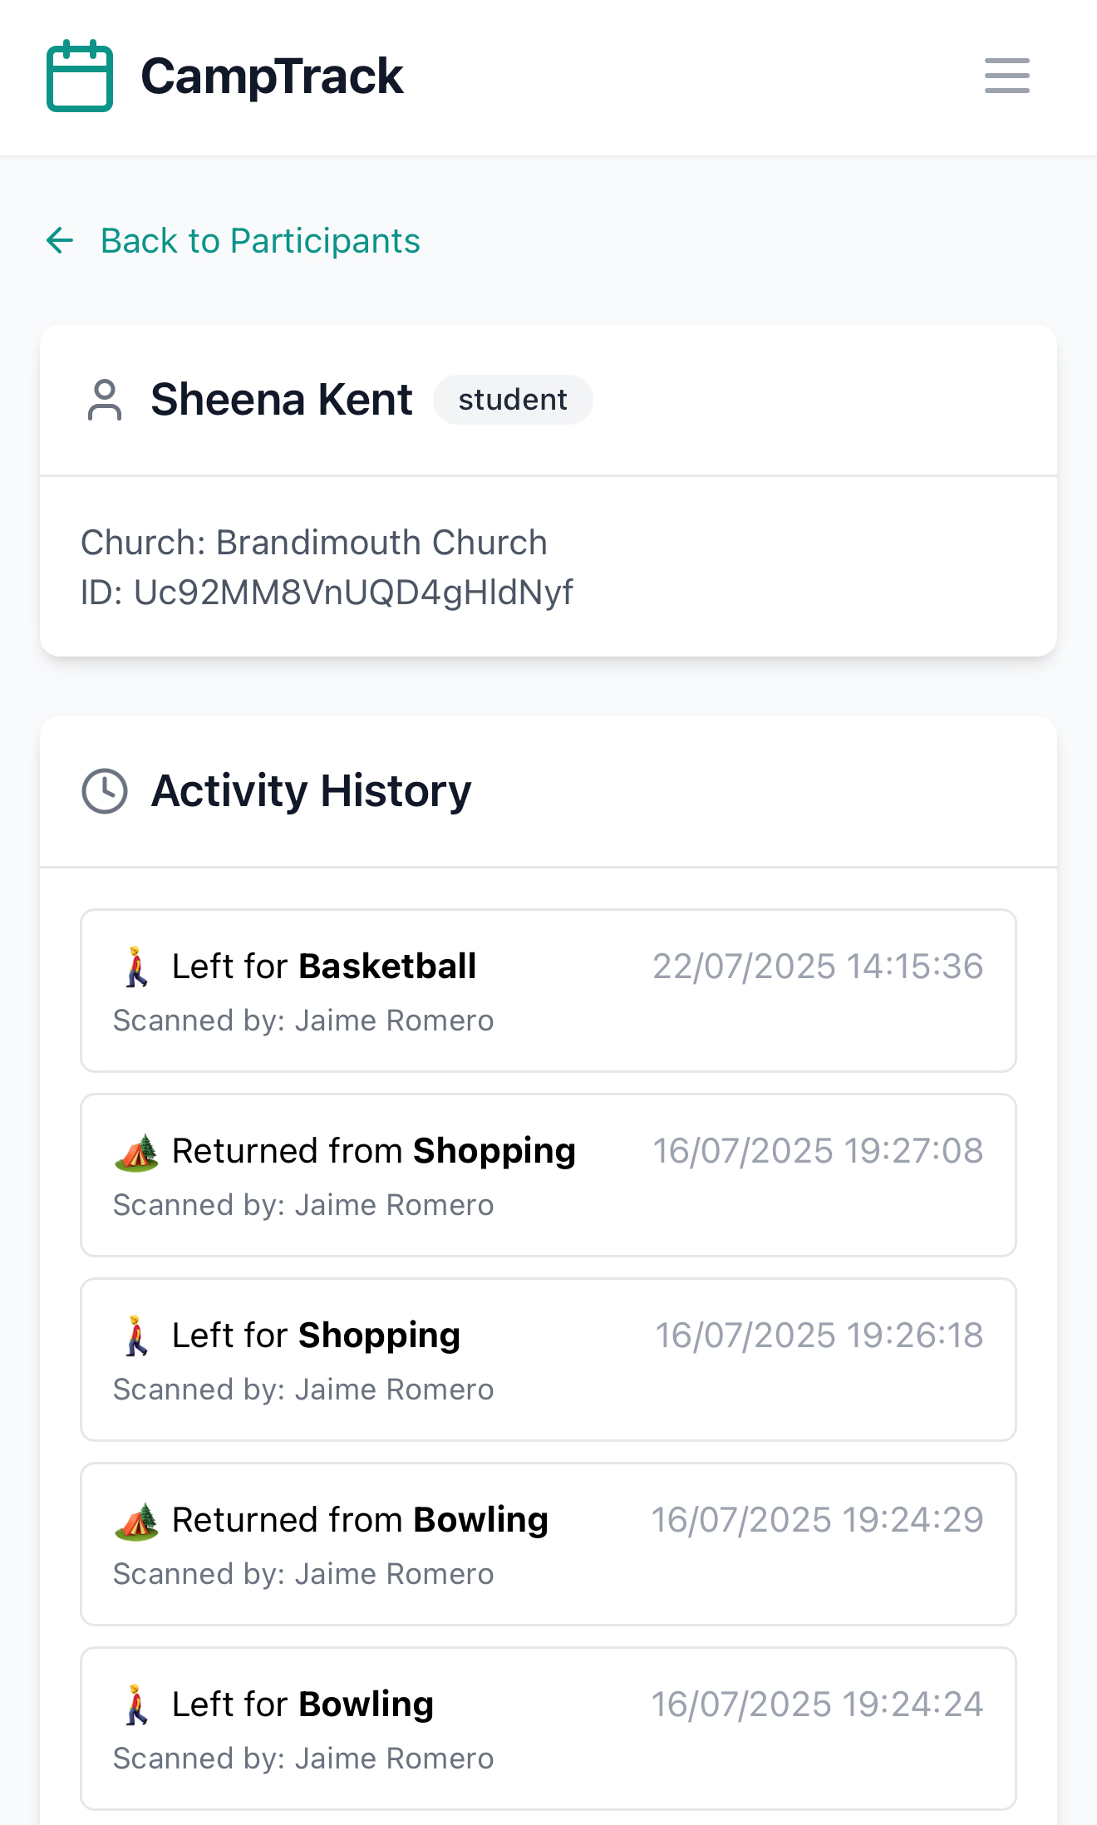
Participant location
In the participant’s scan history, you’ll see who scanned them, the time, and the related activity details.

Slide 16
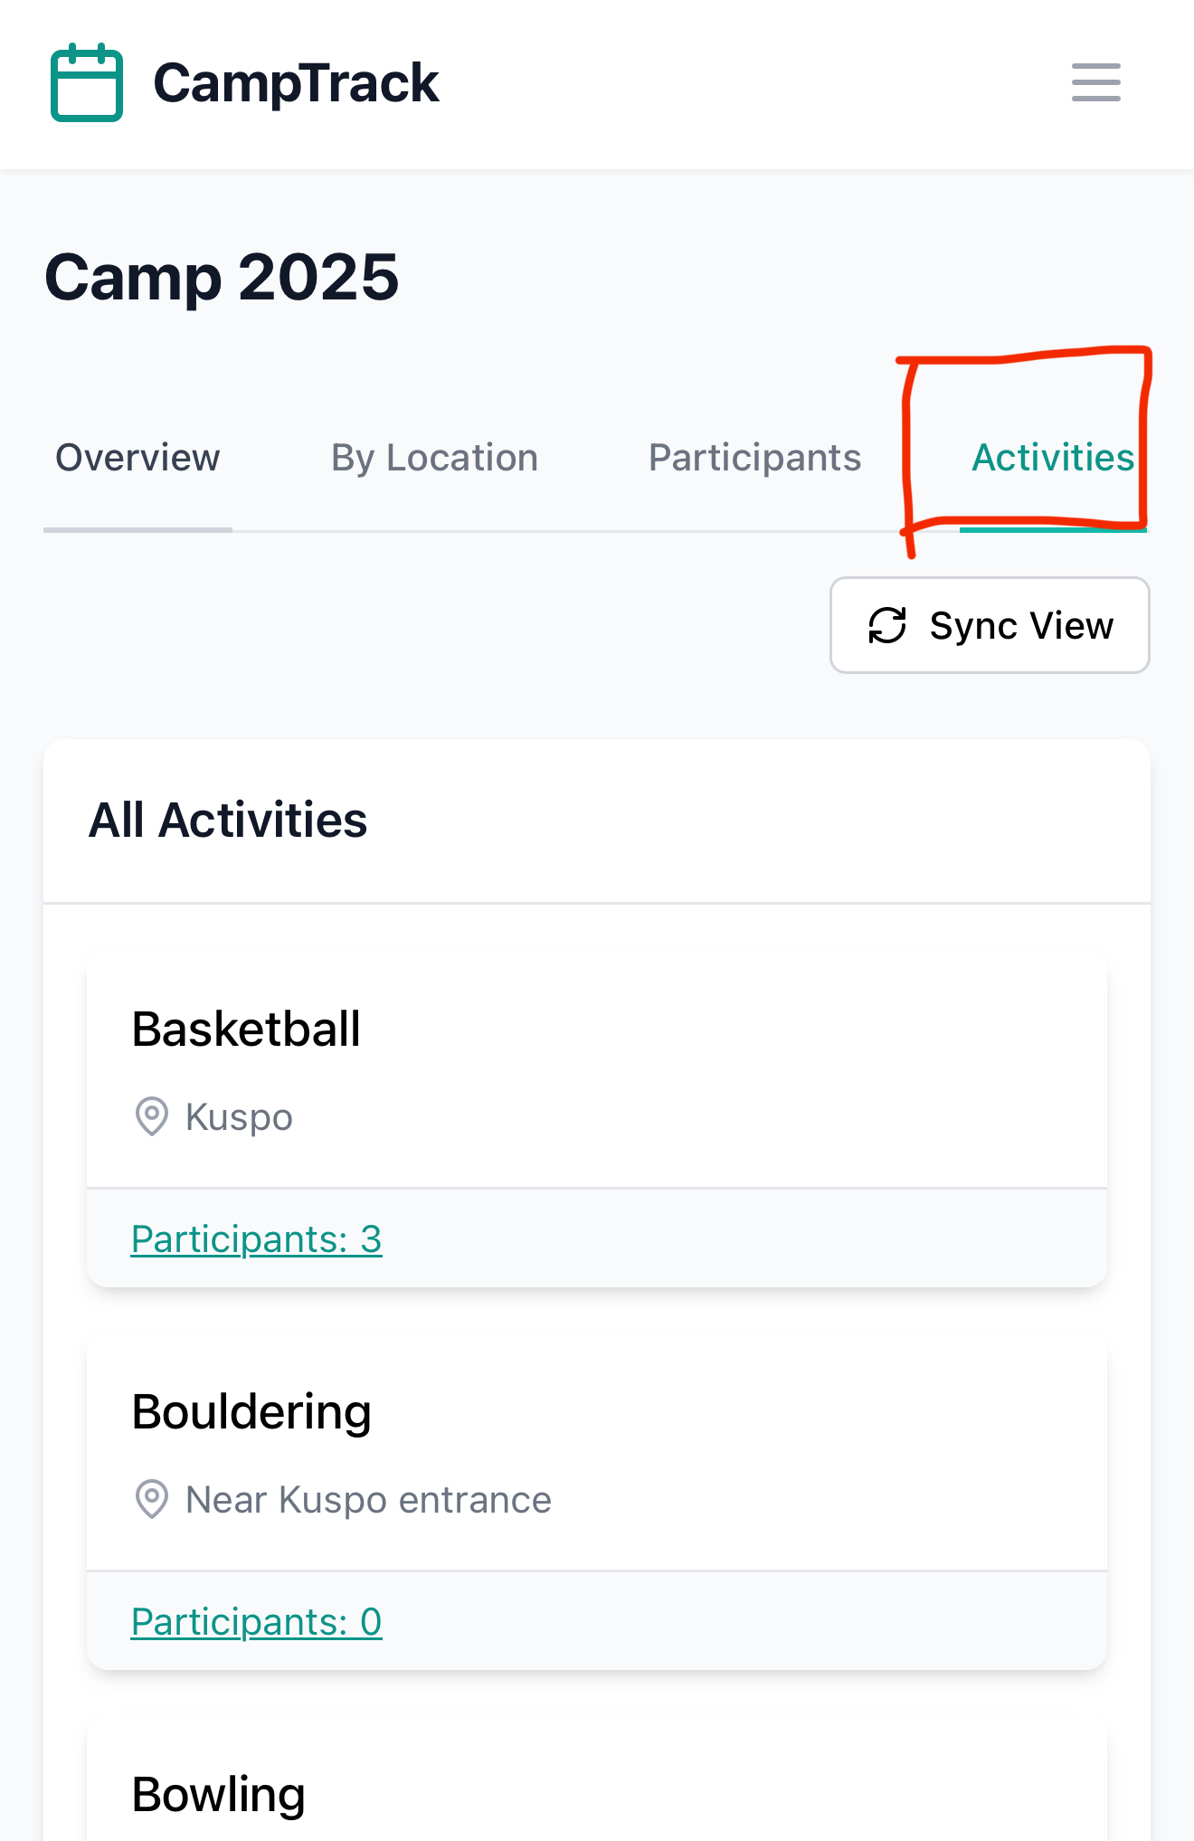
Activity
In the Activities tab, you can view all available activities along with their number of active participants.
You can also tap any activity to see its participant list.

Slide 17
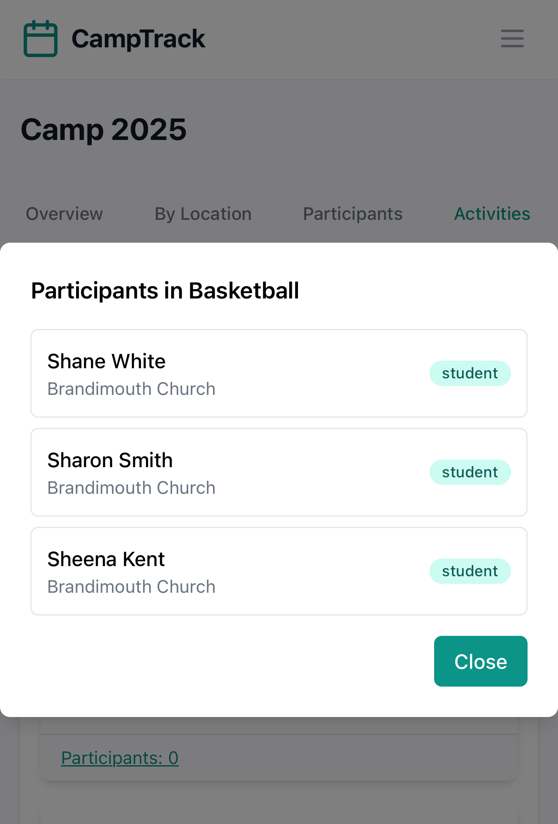
Activity
This concludes the overview of all app features available to Camp Leader users.

Slide 18
Admin-only options
The actions in this section are available exclusively to Admin users.

Slide 19
Manage Participants
To manage camp participants, tap Manage Participants on the dashboard or access it from the app menu.

Slide 20
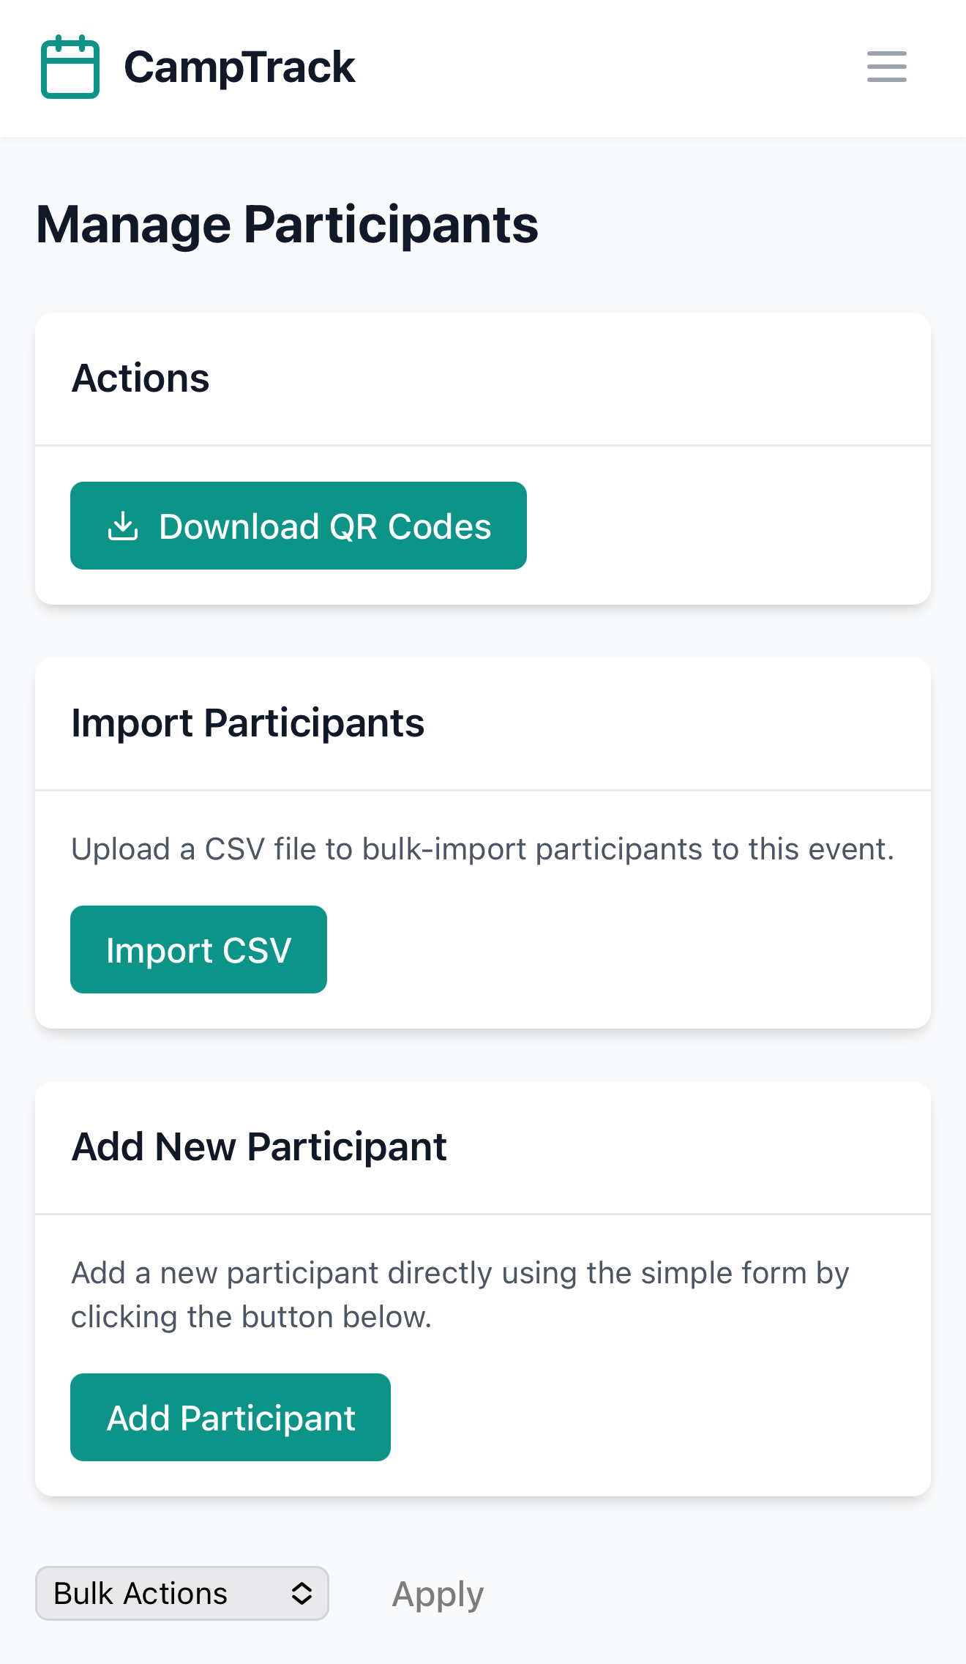
Manage Participants
In this section, you can download participant QR codes, import participants from a file, or add new participants manually.

Slide 21
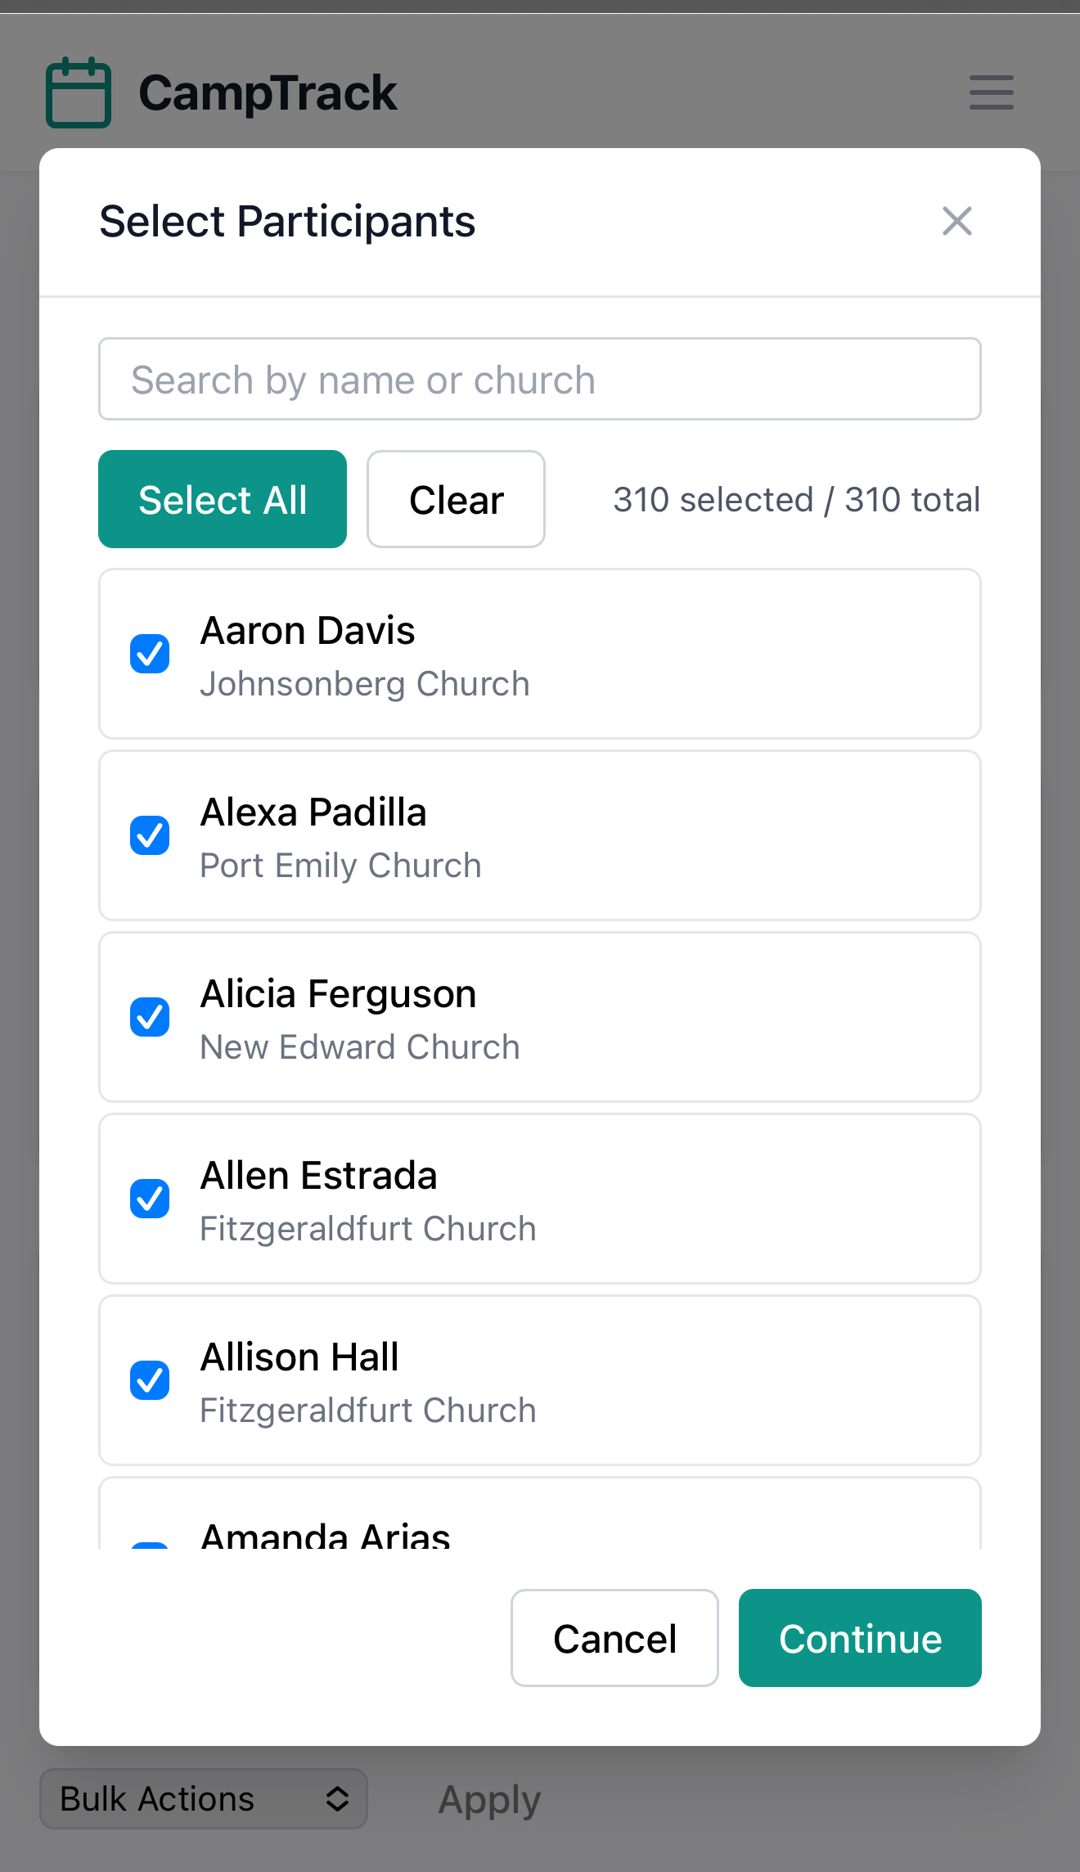
Manage Participants
To download QR codes, simply select the participants you want, tap Continue, and follow the instructions.

Slide 22
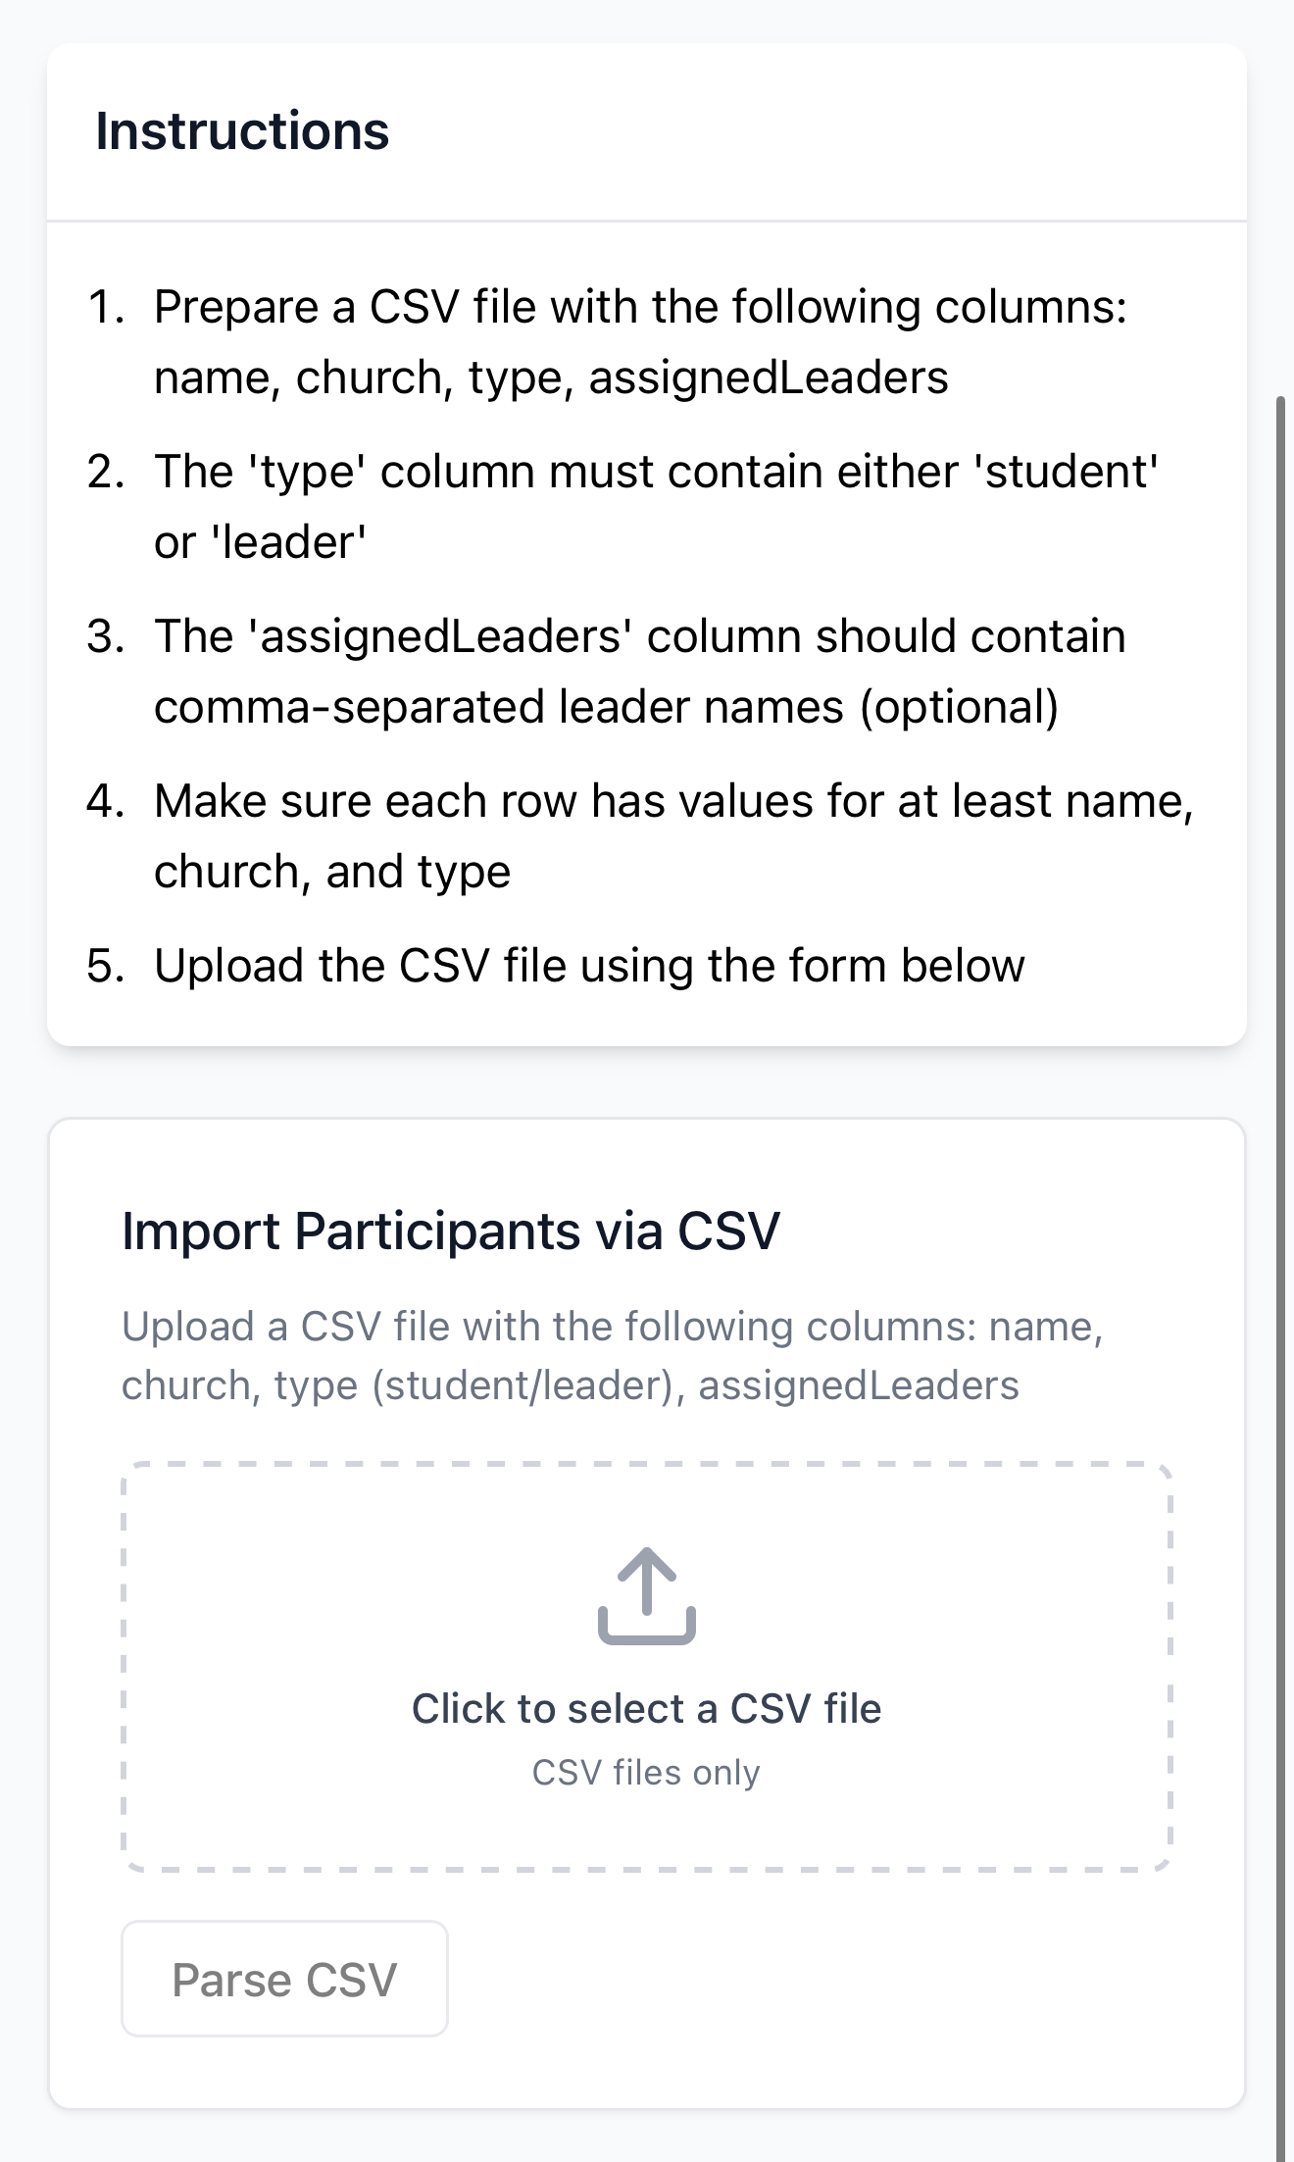
Manage Participants
To import participants, upload a file that strictly follows the given instructions.
Tap Parse, then Upload.
Note: Re-importing an existing participant will not create duplicates.

Slide 23
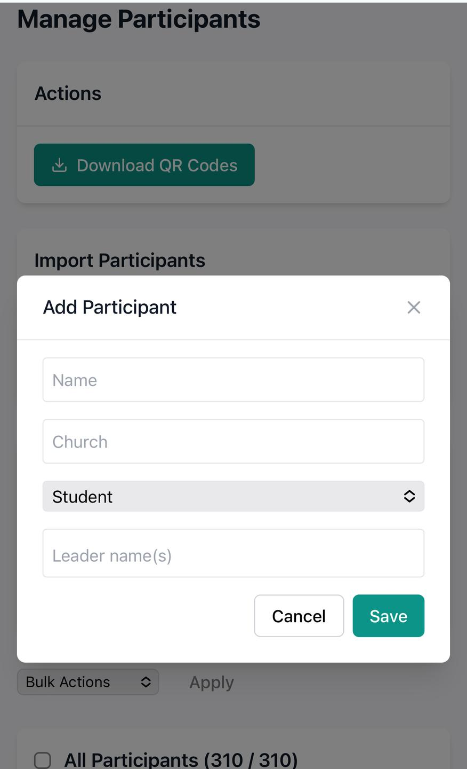
Manage Participants
You can also add a participant manually.
Name and Church fields are required.
Be sure to select the participant type, and optionally add their leader name(s).

Slide 24
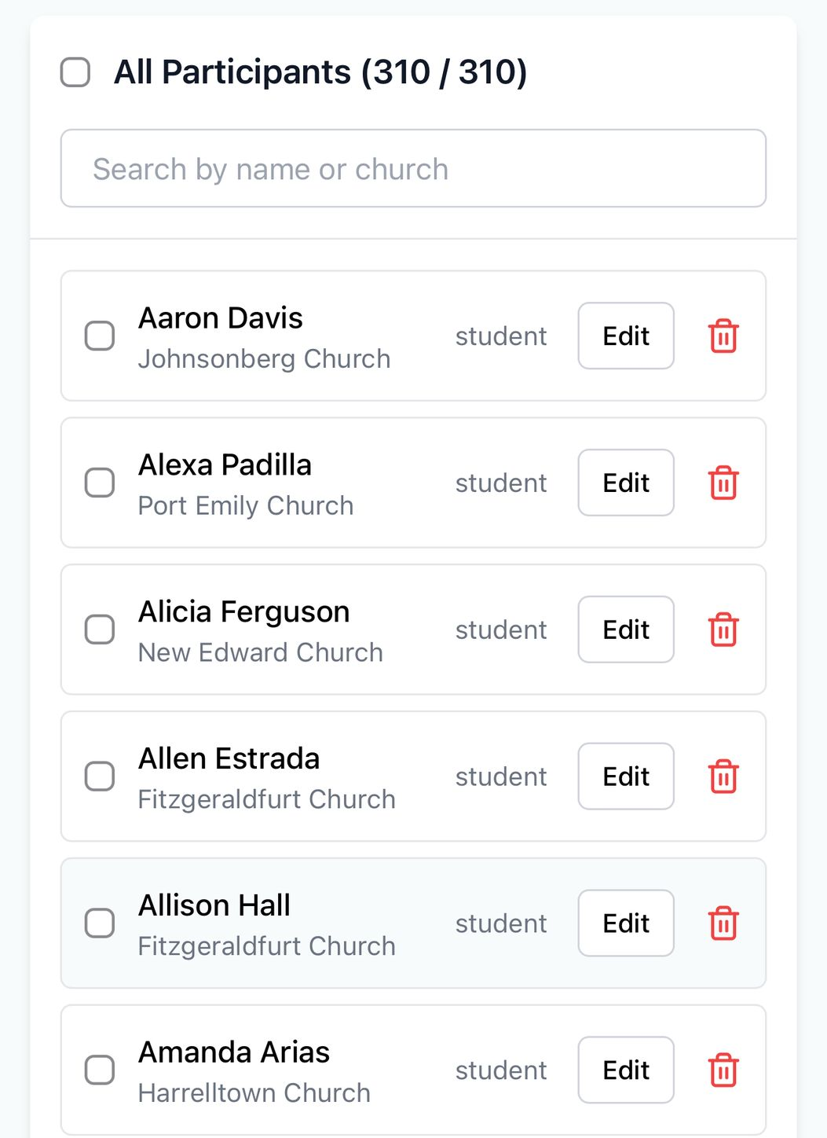
Manage Participants
Scrolling down, you can edit or bulk-delete participants.
Note: Deleting a participant will also permanently remove all of their activity logs.

Slide 25
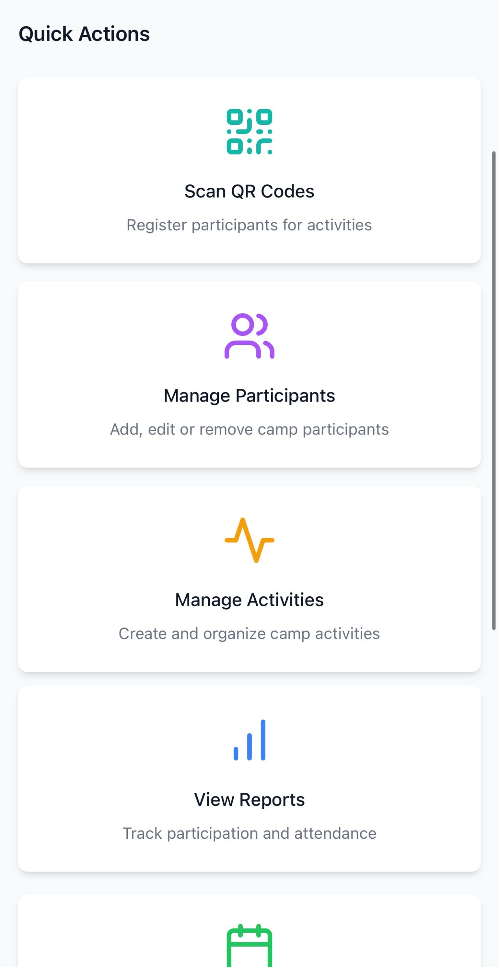
Manage Activities
To manage camp activities, tap Manage Activities on the dashboard or access it from the app menu.

Slide 26
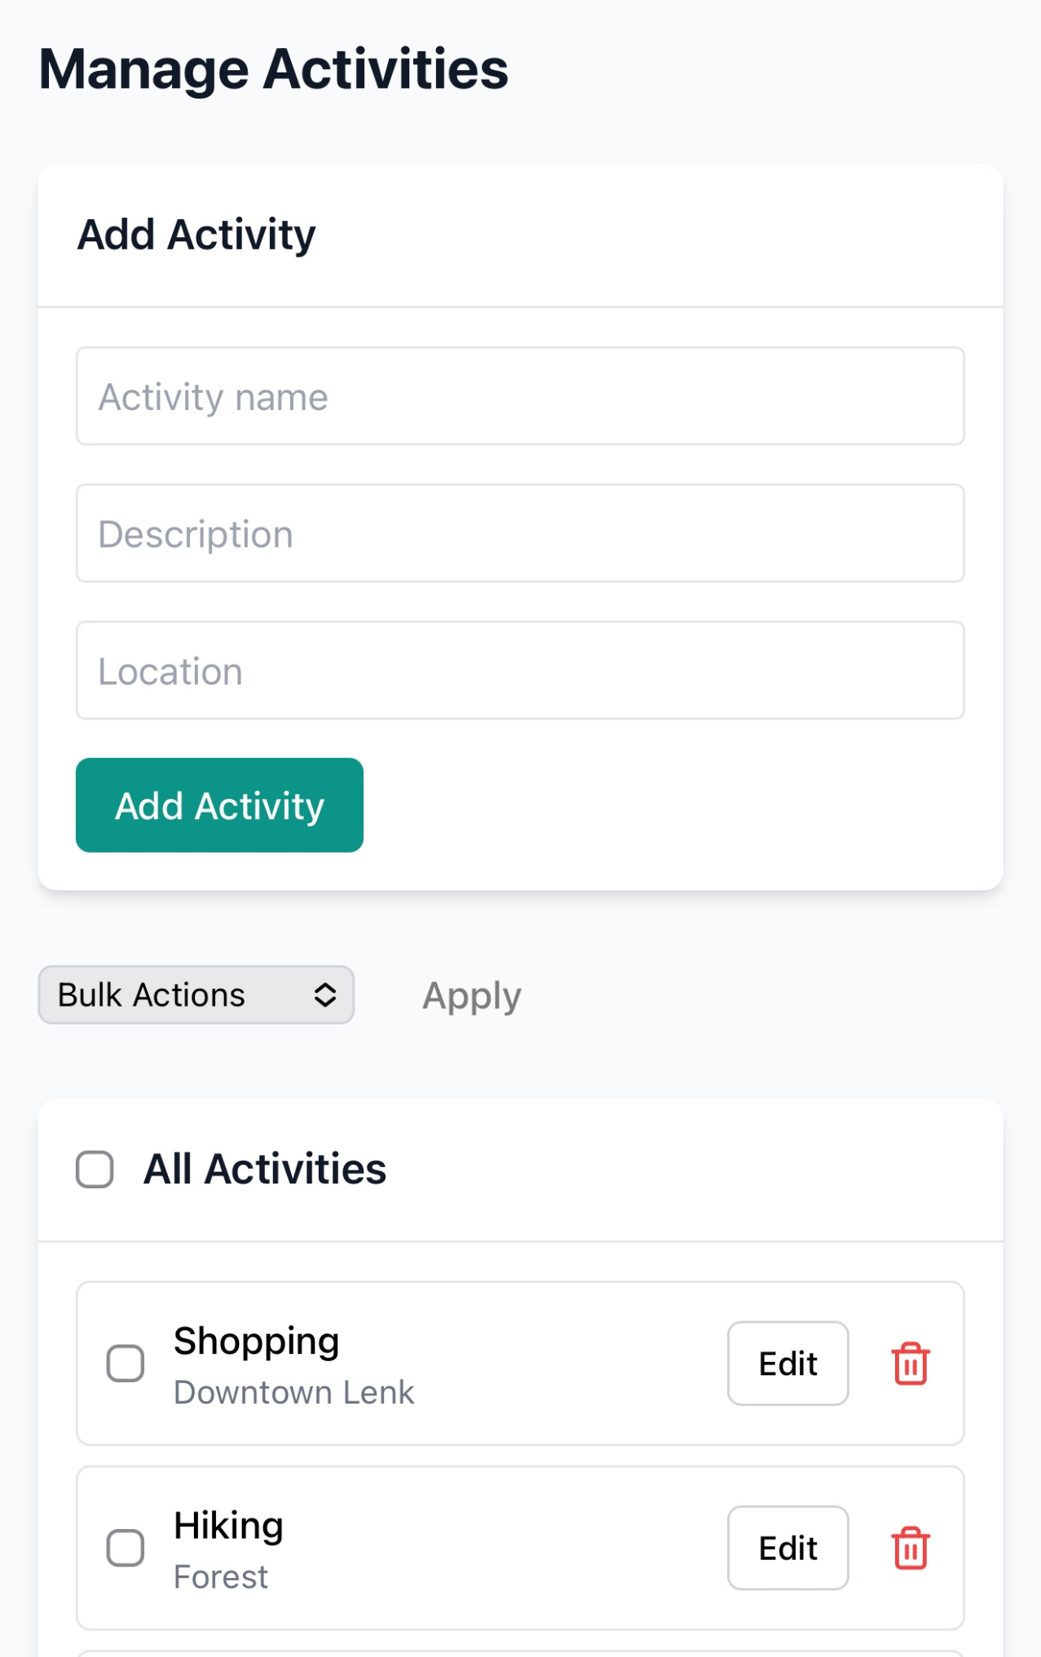
Manage Activities
In this section, you can add new activities, or edit and delete existing ones—just like with participants.

Slide 27
View Reports
To view the camp reports, tap View Reports on the dashboard or access it from the app menu.

Slide 28
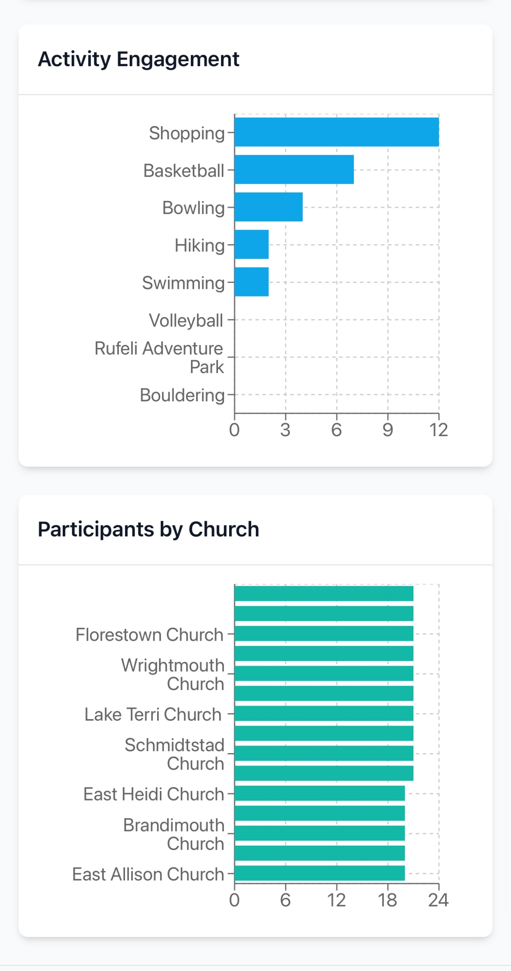
View Reports
In this section, you can view various reports, such as the most popular activities and the churches with the most participants.

Slide 29
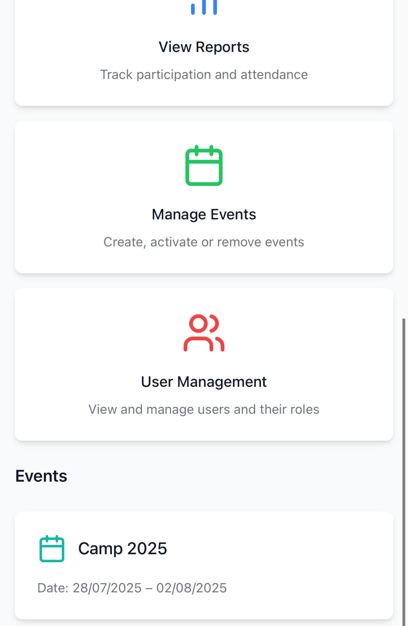
Manage Events
To manage events, tap Manage Events on the dashboard or access it from the app menu.
In the app, an event represents one edition of the camp (e.g., Camp 2025 is one event).

Slide 30
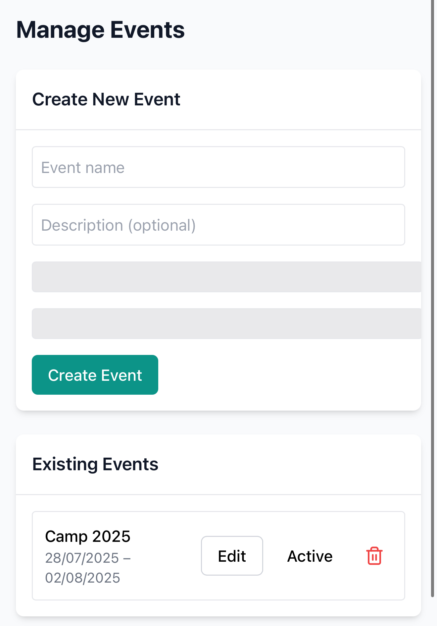
Manage Events
In this section, you can create a new event, edit the dates or description of an existing one, set an active event, or delete an event.
Notes:
Deleting an event will permanently remove all participant and activity data linked to it.
Only one event can be active at a time, and all operations will apply to the currently active event.

Slide 31
User Management
To manage app users, tap Manage Users

Slide 32
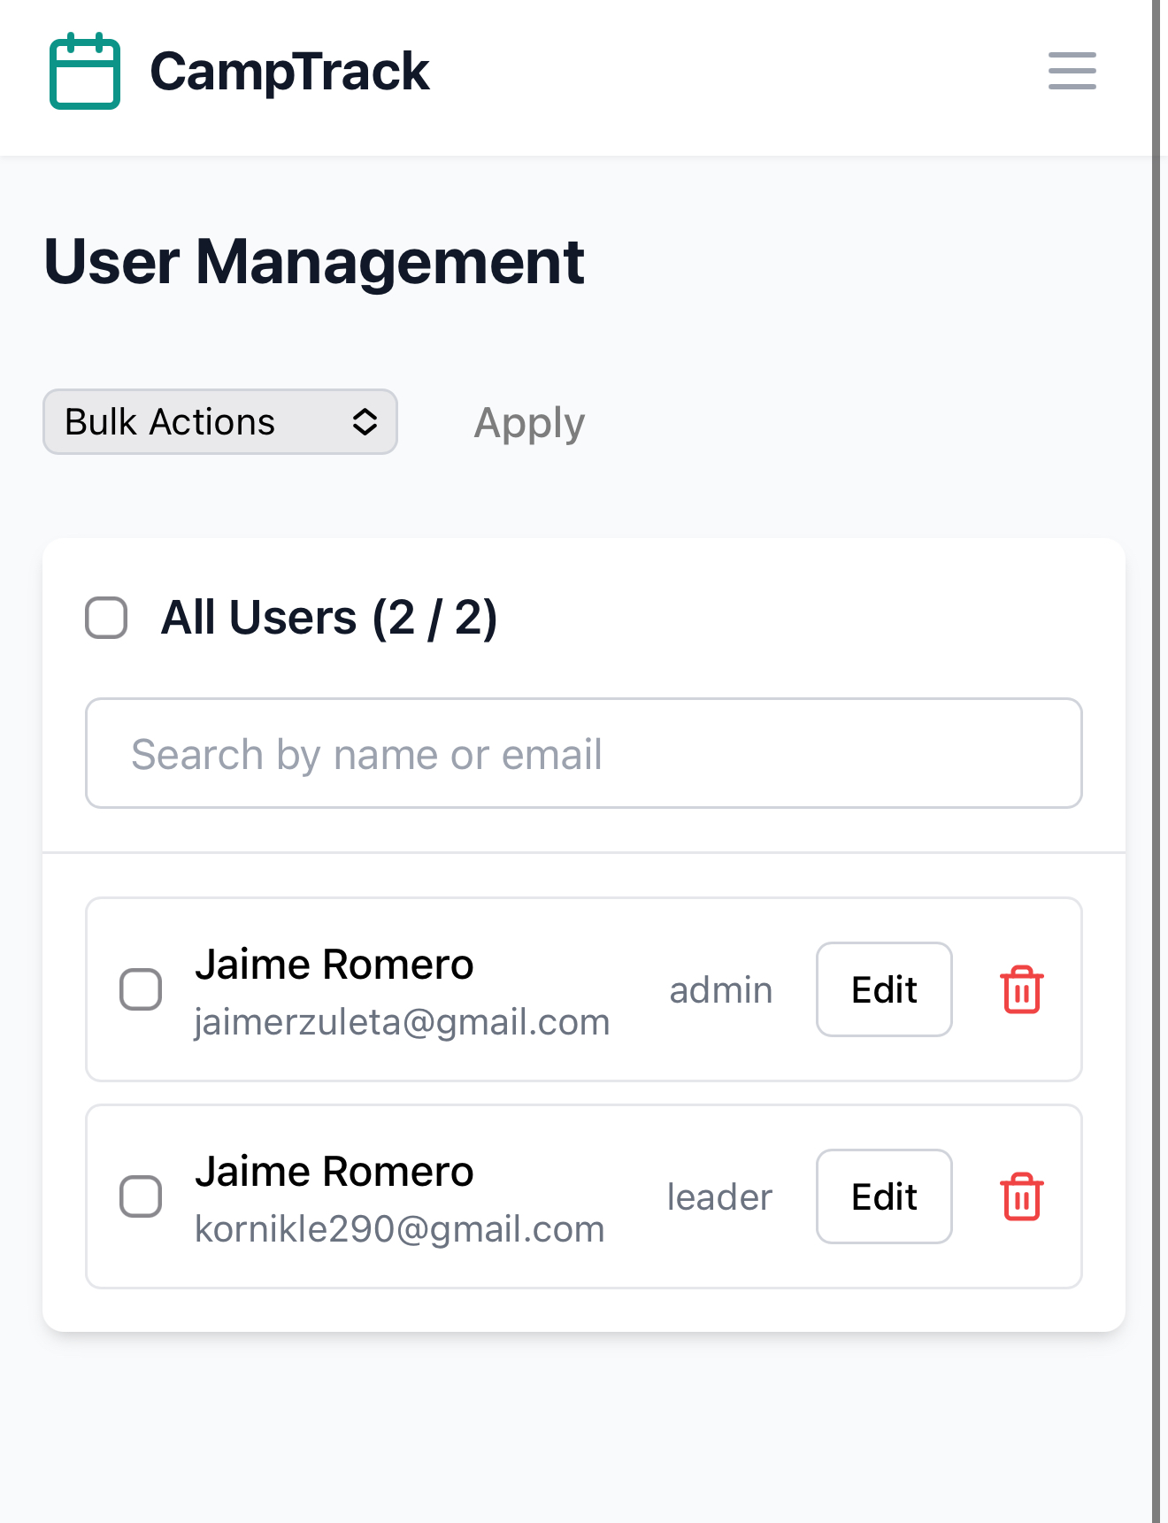
User Management
In this section, you can edit user names, delete users, or change a user’s type (from Camp Leader to Admin, or vice versa).
However, admins cannot modify a user's email or change their password.
Only the user can reset their password from the login screen.

